Slide 1
Clustering Gait Data using different machine learning techniques and finding the best technique
Presented by
ANUBHA PARASHAR
Computer Science and Engineering
MANIPAL UNIVERSITY, JAIPUR.

Slide 2
Outline
GAIT/ Human GAIT
AIM
Proposed work and Methodology
Data Collection & Demos
Conclusion
Result analysis
Clustering of gait data using SOM, K-Mean
Problem Statement
Proposed Solution

Slide 3
What is GAIT?
Gait
Gait refers to the manner in which a person walks, and is one of the few biometric traits that can be used to recognize people at a distance.
Therefore, this trait is very appropriate in surveillance scenarios and gait recognition system.

Slide 4
Human gait
Human gait analysis refers to the study of human locomotion.
Applications are in a large variety of domains, including entertainment, healthcare and pedestrian navigation.
The act of walking involves the coordination of different human body parts, such as the skeleton, the muscle and the neural systems.
Various factors can affect the complex interaction between the body parts, for example any pathological nature will require a distinction between ― normal gait and pathological gait.
Normal gait refers to the general human walking parameters without differentiating the age, sex or physical parameters.
pathological gait refers to an abnormal gait, for example affected by pathologies such as muscle weakness or skeleton deformities.

Slide 5
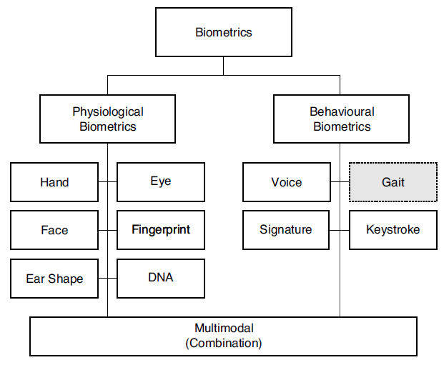
Problem Statement
To verify/validate the identity of people is called as authentication.
And now a day’s authentication is becoming very popular to check whether a person is authentic or not.
Previously authentication was done with secret passwords or PIN codes. The disadvantage of such authentication systems was anyone could crack the password or PIN codes.
So, biometric (in fig.) technology came to existence where authentication is done using a particular body part like fingers, iris etc. But now a days these biometrics are not user friendly as people dislike accessing finger print machine or avoid iris scanner as it may weaken or damage their vision.

Slide 6
Proposed Solution
Identifying normal or pathological human gait. Therefore a robust method for detecting and capturing the body, face and/or gait of each individual person has to be found.
Human gait is supposed as unique biometric identification like thumb print.
So in GAIT analysis to examine the human walking moment we collect and analyze the data.
Human gait can be utilized to identify people for diverse security reason and exercised before to detect many abnormalities.

Slide 7
Proposed Solution
We have developed the computational model for prediction, formal verification and analyses of bipedal locomotion using machine learning technique for modelling.
Input
Data Preprocessing
Gait Cycle Detection
Feature Extraction
Clustering
(K-Mean)
(SOM)
Output

Slide 8
Empirical Study of Gait by HMCD

Slide 9
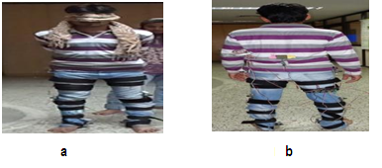
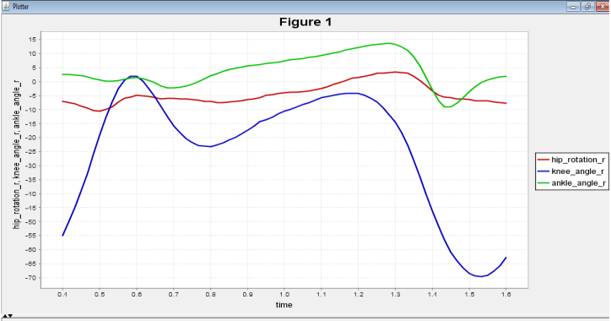
METHODOLOGY
TO GATHER DATA AND EXTRACT FEATURE
Data is captured using body sensor based Human Motion Capture Device (HMCD) and potentiometer.

Slide 10

AIM
The aim of the paper is to evaluate and implement robust and accurate method to identify whether it’s a normal gait or pathological gait.

Slide 11
Methodology
Sunday, August 7, 2016

Slide 12
Methodology
Firstly we collect the GAIT data then features are extracted and we cluster the GAIT dataset.
Training and testing of system is done.
After the Clustering is done result is shown as normal or pathological GAIT.
Then 10 fold cross-validation test is also conducted to validate the statistical significance of the results.

Slide 13
Data Collection
HMCD
To capture the human data we use HMCD. From this device different joint angles are captured to get the human GAIT data.

Slide 14
Analysis of dataset
When the dataset is simulated, then the coordinates of the human GAIT data set is captured and shown in figure for crouch2, crouch3, crouch4, normal datasets respectively.

Slide 15
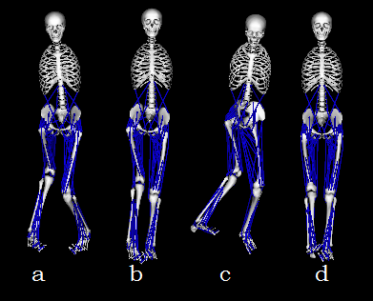
Simulation of dataset in openSim

Slide 16
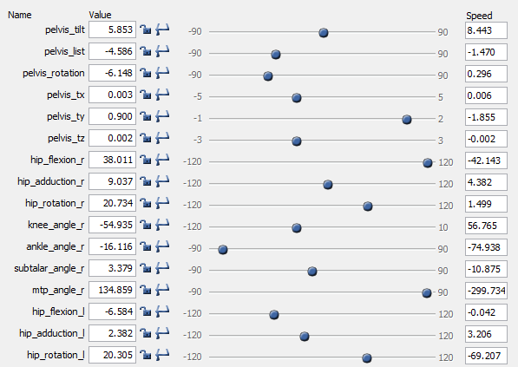
Values of crouch2 dataset

Slide 17
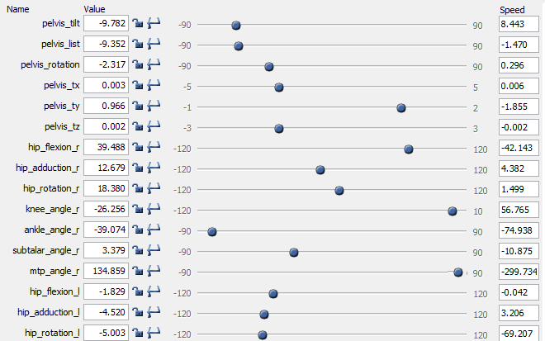
Values of crouch3 dataset

Slide 18
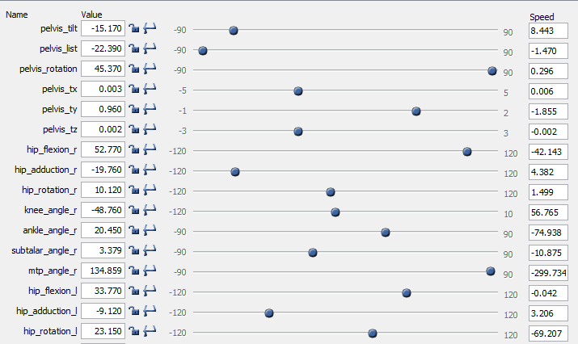
Values of crouch4 dataset

Slide 19
Values of normal dataset

Slide 20
Feature Selection
Feature Category | Feature Name
F1 | Pelvis_tilt
F2 | Pelvis_list
F3 | Pelvis_rotation
F4 | Pelvis_tx
F5 | Pelvis_ty
F6 | Pelvis_tz
F7 | hip_flexion_r
F8 | hip_adduction_r
F9 | hip_rotation_r
F10 | knee_angle_r
F11 | ankle_angle_r
F12 | ankle_angle_l
F13 | knee_angle_l
F14 | hip_flexion_l
F15 | hip_adduction_l
F16 | hip_rotation_l

Slide 21
Clustering
K-Mean, SOM

Slide 22
CLUSTERING
CLUSTERING is a collection of different methods for categorizing data.
To correctly cluster the data one wishes to find features that separate each group of data into clusters.

Slide 23
CLUSTERING
CLUSTERING of GAIT data is done using two following techniques:
K-Mean
SOM

Slide 24
K-Mean
The k-mean algorithm is generally used for compact clustering.
It is very much sensitive for outlier and noise.
It is applicable only for numerical data.

Slide 25
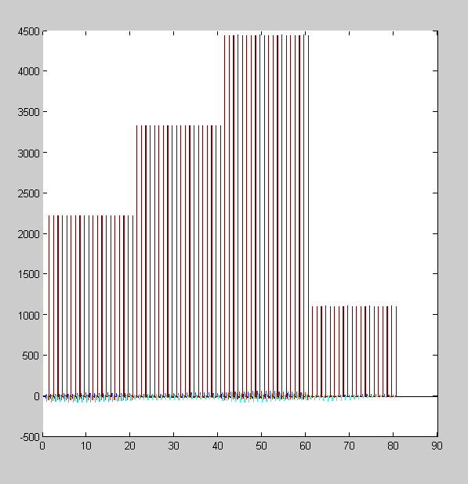
K-Mean Result

Slide 26
K-Mean Result
Exp. No | Training accuracy (%) | Test accuracy (%)
1 | 100 | 80

Slide 27
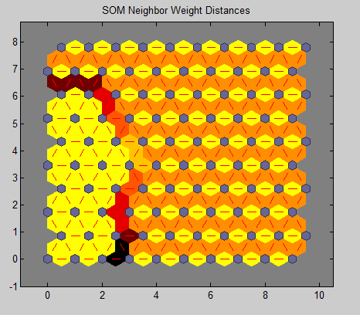
SOM
SOM is unsupervised learning method.
SOM is used to map the training samples and thus is known as self-organising maps

Slide 28
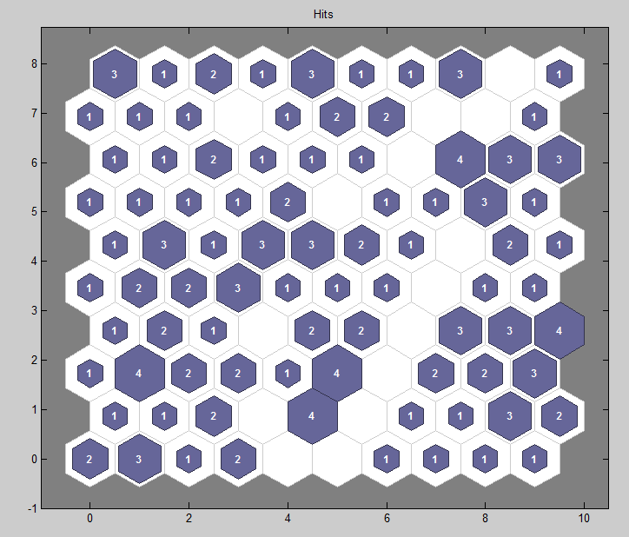
Cluster of Dataset

Slide 29
Result
Exp No. | Training accuracy (%) | Test accuracy (%)
1. | 100 | 71

Slide 30
Comparison of success rate by different algorithms using 10–fold cross validation
Classifier | Rate of Success (%)
K-Mean | 80
SOM | 71
Correlation coefficient 0.9955
Mean absolute error 8.2394
Root mean squared error 117.3938
Relative absolute error 0.741 %
Root relative squared error 9.4381 %
Total Number of Instances 203

Slide 31
Conclusion
The proposed system can be used for developing a gesture controlled hexadecimal keyboard making human-computer interaction easier, surveillance scenarios, in detecting disease of sports person and gait recognition system.
After this, 10-fold cross validation was used to provide overall accuracy of the system.
Overall accuracy was observed to be 90.23, 85.50% using the K-Mean and SOM.

Slide 32
Questions?

Slide 33
Thank you
Have a great day!

Slide 34
References
[1] Mark, Afolabi, and Olatoyosi Olude. Predicting NurnberofComponents Organizing Map (SOM). Proceedings ofthe 40th Hawaii International Conference on System Scienes, Figure 1. K-means clustering accuracy 2007.
[2] Faber, Vance. Clustering and the Continuous k machines proved to be the comparable methods for Means Algorithm. Los Alamos Science. Vol 22. this application for K-means clustering; which http://www.fas.org/sgp/othergov/doe/lanl/pubs/00412 are both fairly close values.

